Slide 1
Hyperparameters
By: Shivani Sheth

Slide 2
Contents
Introduction
Deep double descent
Effects of Data Parallelism on Neural Network Training

Slide 3
Introduction
In machine learning, a hyperparameter is a parameter whose value is used to control the learning process. By contrast, the values of other parameters, such as weights, are derived via training.
Can be roughly divided into: Optimization Hyperparameters: Learning rate, Mini-Batch Size, Number of Epoch. Model Hyperparameters: Number of hidden units, Number of layers.
Heuristics: Manual Search, Grid Search, Random Search, Bayesian Optimisation.

Slide 4
Deep Double Descent

Slide 5
Conventional wisdoms
The bias-variance trade-off – “larger models are worse”.
Neural networks in practice – “larger models are better”.
Both classical statisticians and deep learning practitioners agree on - “more data is always better”.

Slide 6
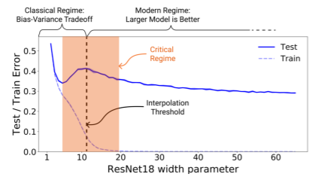
Double Descent Overview
In the under-parameterized regime, where the model complexity is small compared to the number of samples, the test error as a function of model complexity follows the U-like behaviour predicted by the classical bias/variance trade-off.
Once model complexity is sufficiently large to interpolate i.e., achieve (close to) zero training error, then increasing complexity only decreases test error, following the modern intuition of “bigger models are better”.

Slide 7
Double Descent Overview
Model-wise double descent. - Test error with respect to increase in model size/ parameters.
Epoch-wise double descent. - Test error of a fixed, large architecture over the course of training.
Sample-wise non-monotonicity. - Test error of a fixed model and training procedure, for varying number of train samples.
Label noise. - All forms of double descent most strongly occur in settings with label noise in the train set (often the case when collecting train data in the real-world).

Slide 8
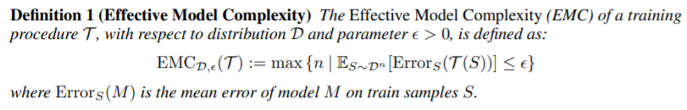
Effective Model Complexity
Maximum number of samples ‘n’ on which the training procedure achieves on average ≈ 0 training error.

Slide 9
Generalized Double Descent hypothesis
Under-parameterized regime - If EMC(T) is sufficiently smaller than n, then an increase in the effective complexity of the model will decrease the test error.
Over-parameterized regime - If EMC(T) is sufficiently larger than n, then an increase in the effective complexity of the model will decrease the test error.
Critically parameterized regime - If EMC(T) ≈ n, then an increase in the effective complexity of the model might decrease or increase the test error.

Slide 10
Experimental Setup
Architectures: ResNets, standard CNNs, and Transformers.
Loss: Train with cross-entropy loss.
Optimizers: SGD and Adam.
Datasets: CIFAR10, CIFAR100, IWSLT ’14 (German - English), WMT ’14 (English - French) .
Label Noise: Label noise of probability p refers to training on samples which have the correct label with probability (1 − p), and a uniformly random incorrect label otherwise.

Slide 11
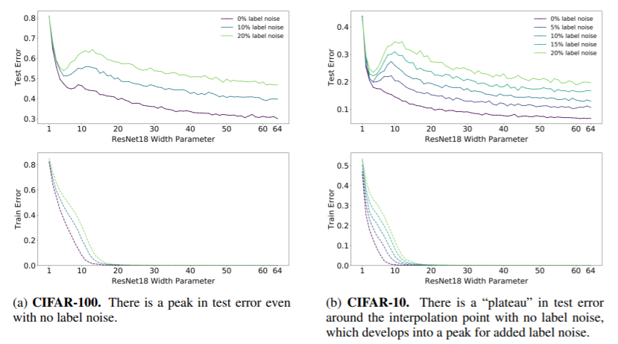
Model-wise double descent
The critical region exhibits distinctly different test behaviour around the interpolation point and there is often a peak in test error that becomes more prominent in settings with label noise.

Slide 12
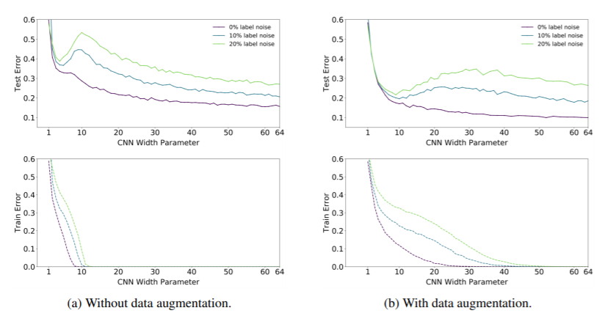
Model-wise double descent
All modifications which increase the interpolation threshold (such as adding label noise, using data augmentation, and increasing the number of train samples) also correspondingly shift the peak in test error towards larger models.

Slide 13
Intuition for deep double descend
For model-sizes at the interpolation threshold, there is effectively only one model that fits the train data and this interpolating model is very sensitive to noise in the train set. Since the model is just barely able to fit the train data, it fits even the noisy or mis-specified labels that will destroy its global structure, and result in a high test error.
However for over-parameterized models, there are many interpolating models that fit the train set, and SGD is able to find one that “memorizes” or “absorbs” the noise while still performing well on the distribution.

Slide 14
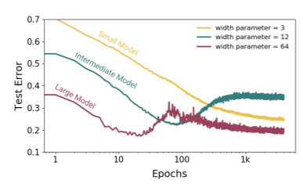
Epoch-wise double descent
Increasing the train time increases the EMC and thus, a sufficiently large model transitions from under- to over-parameterized over the course of training.

Slide 15
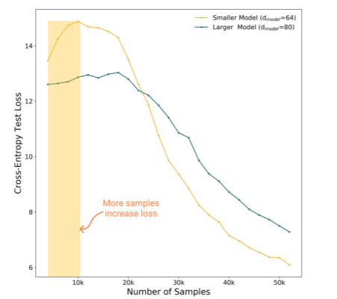
Sample-wise non-monotonicity
By increasing the train samples ‘n’, the same training procedure ‘T’ can switch from being effectively over-parameterized to effectively under-parameterized.
There is a regime where more samples hurt performance.

Slide 16
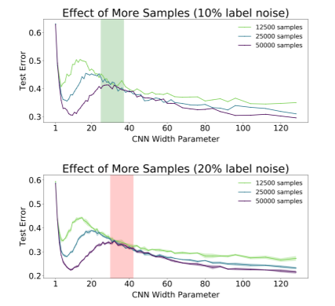
Sample-wise non-monotonicity
There is a range of model sizes where having 4× more train samples does not help test performance when training to completion. Outside the critically-parameterized regime, for sufficiently under- or overparameterized models, having more samples helps.

Slide 17
Effects of Early Stopping and Label Noise
Early stopping: Double descent does not occur with optimal early-stopping. This is because early stopping prevents models from reaching 0 train error then we would not expect to see double descent, since the EMC does not reach the number of train samples
Label noise: Double descent most strongly occurs in settings with label noise.

Slide 18
Conclusion
Models and training procedures exhibit atypical behaviour when their Effective Model Complexity is comparable to the number of train samples.
Provides a useful way of thinking for practitioners - if a model and training procedure are just barely able to fit the train set, then small changes to the model or training procedure may yield unexpected behaviour.

Slide 19
Effects of Data Parallelism on Neural Network Training

Slide 20
Advances in Neural Networks
Success of neural networks in a variety of prediction tasks, including image classification, machine translation, and speech recognition are partly driven by hardware and software improvements that significantly accelerate neural network training.
Advances in the amount of computation available for neural network training would make it possible to train models even faster and facilitate even greater improvements to model quality.
The most common way to utilize massive compute power is to distribute computations between different processors and perform those computations simultaneously.

Slide 21
Model parallelism
One way to distribute computations is through model parallelism, which involves distributing the neural network across different processors.
Model parallelism makes it possible to train neural networks that are larger than a single processor can support. However, it usually requires tailoring the model architecture to the available hardware.

Slide 22
Data Parallelism
Another way to distribute computations is through data parallelism, which refers to distributing training examples across multiple processors to compute gradient updates (or higher-order derivative information) and then aggregating these locally computed updates.
Data parallelism is model agnostic and applicable to any neural network architecture. It is the simplest and most widely used technique for parallelizing neural network training.
For the most common neural network training algorithms (synchronous stochastic gradient descent and its variants), the scale of data parallelism corresponds to the batch size and the number of training examples used to compute each update to the neural network.

Slide 23
Training Cost
The training cost of the model can be mainly computed through its training time and hardware costs.
Training time can be decomposed into number of steps multiplied by average time per step, and hardware cost into number of steps multiplied by average hardware cost per step.
The per-step time and hardware costs depend on the practitioner’s hardware, but the number of training steps is hardware-agnostic and can be used to compute the total costs for any hardware given its per-step costs.

Slide 24
Contributions
Relationship between batch size and number of training steps to reach a desired test error has the same characteristic form across six different families of neural network, three training algorithms, and seven data sets.
Maximum useful batch size varies significantly between workloads and depends on properties of the model, training algorithm, and data set.
Optimal values of training hyperparameters do not consistently follow any simple relationships with the batch size. Popular learning rate heuristics, such as linearly scaling the learning rate with the batch size, do not hold across all problems or across all batch sizes.

Slide 25


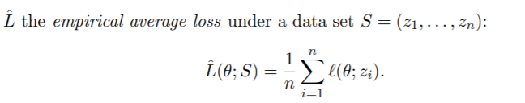

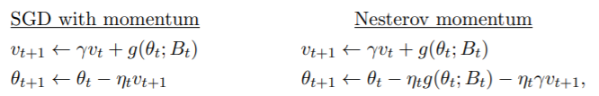
Setup - Training Objective and Optimizers
Training Objective
Optimizers
Mini-batch stochastic gradient descent.
Variants - SGD with momentum and Nesterov momentum optimizers.
R : Differentiable penalty
Lambda : Regularization weight
Gamma: scalar between 0 and 1.

Slide 26
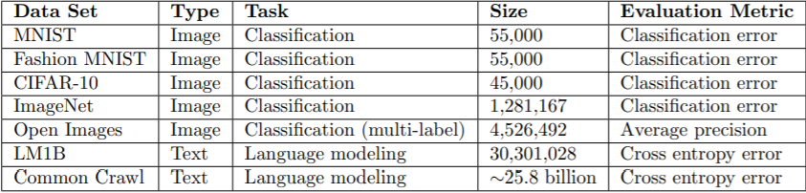
Setup - Dataset
Size: Number of examples in the training set.

Slide 27
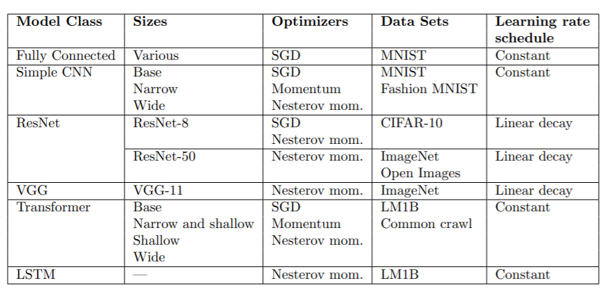
Setup - Models

Slide 28
Experiments and Results
Measure the number of steps needed to first reach a desired out-of-sample error, or steps to result.
As the batch size grows, there is an initial period of perfect scaling, where the steps needed to achieve the error goal halves for each doubling of the batch size. This is followed by a region of diminishing returns that eventually leads to a regime of maximal data parallelism where additional parallelism provides no further benefit.

Slide 29
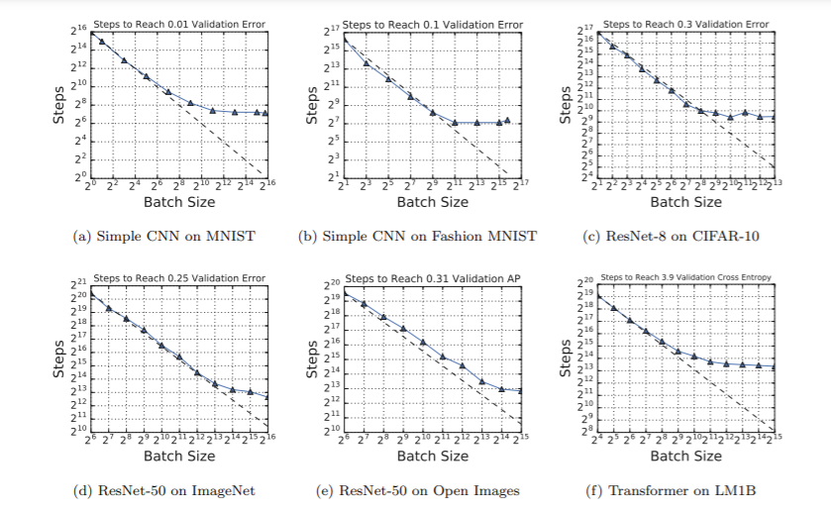

Slide 30
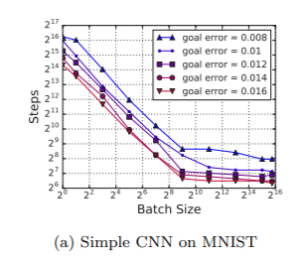
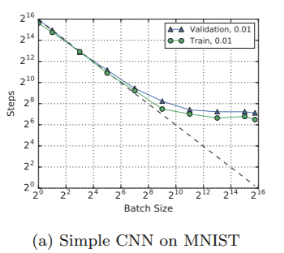
Experiments and Results
Varying the error goal only vertically shifts the steps-to-result curve.
Steps to result on the training set is almost the same as on the validation set.

Slide 31
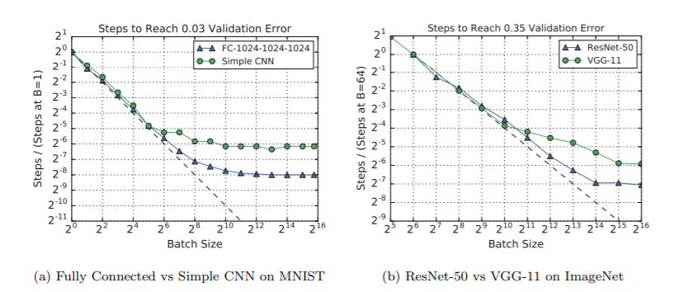
Experiments and Results
Some models can exploit much larger batch sizes than others. Tested by different model architectures on the same data set and optimizer.

Slide 32
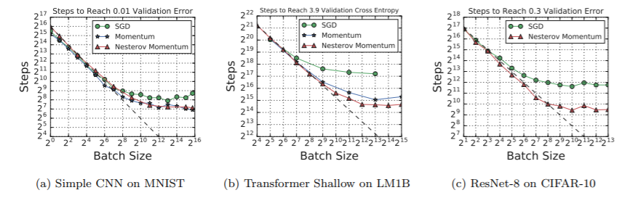
Experiments and Results
Momentum extends perfect scaling to larger batch sizes, but matches plain SGD at small batch sizes. Hence, the optimizers with momentum are able to reduce the steps to result for larger batch sizes.

Slide 33
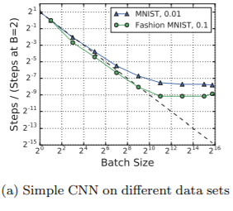
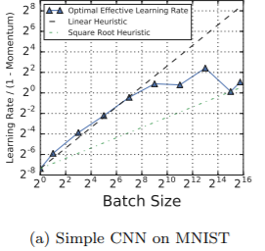
Experiments and Results
The data set somewhat influences the maximum useful batch size.
Optimal effective learning rates do not always follow linear or square root scaling heuristics.

Slide 34
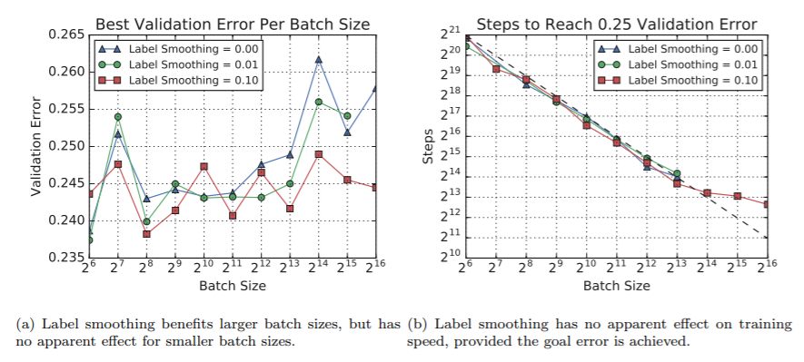
Experiments and Results
Regularization can be more helpful at some batch sizes than others.

Slide 35
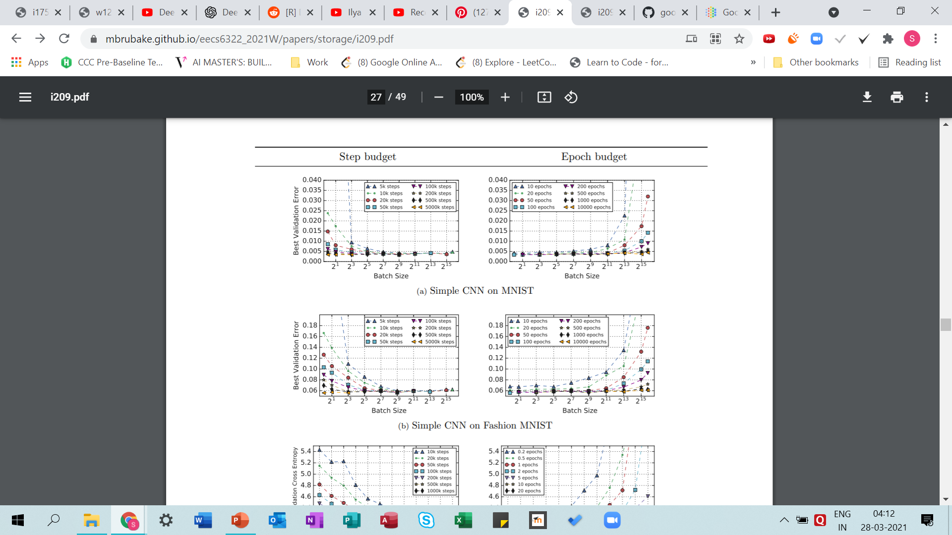
Experiments and Results
Validation error depends on compute budget more than batch size. Step budgets favor large batch sizes, while epoch budgets favor small batch sizes.
This observation is likely to be explained by the fact that for a fixed number of training steps, larger batch sizes train on more data, while for a fixed number of epochs, smaller batch sizes perform more training steps.

Slide 36
Observations
Across all the experiments, increasing the batch size initially reduced the number of training steps needed proportionally. Depending on the workload, this perfect scaling regime ended anywhere from a batch size of 2^4 to a batch size of 2^13.
As batch size increases beyond the perfect scaling regime, there are diminishing returns that end with a maximum useful batch size. Depending on the workload, the maximum useful batch size varied between roughly 2^9 and 2^16 in the experiments

Slide 37
Effect of batch size on model quality
The results comparing SGD and SGD with momentum (or Nesterov momentum) show that momentum can extend perfect scaling to much larger batch sizes, offering clear guidance for practitioners.
Although the model seems to have a large effect on the maximum useful batch size and the limit of perfect scaling, the results do not give definitive answers on exactly how to design models that scale better for a given optimizer and data set. Even when the model family was fixed, the results were somewhat inconsistent by changing the model width and depth.
Unlike the model and optimizer, we generally have much less control over the data set. Unfortunately, properties of the data set also affect how well training scales in practice. The results are equivocal on whether the number of training examples has any effect, but changing the data set entirely can certainly change the scaling behaviour with respect to batch size.

Slide 38
Effect of batch size on model quality
Any study that only tunes the learning rate for one batch size and then uses a heuristic to choose the learning rate for other batch sizes gives a systematic advantage to the batch size used in tuning. The optimal values of hyperparameters, such as the momentum and learning rate decay schedule, should not be assumed to remain constant or scale in a simple way as the batch size increases.
Assuming an epoch budget when comparing solution quality between batch sizes limits an investigation to the perfect scaling region of the steps to result vs batch size curve. This budget favours smaller batch sizes because they will perform more optimizer steps for the same number of training examples.

Slide 39
Effect of batch size on model quality
Assuming a step budget when comparing solution quality between batch sizes, larger batch sizes might be favoured because they will see more training examples for the same number of gradient updates.
Increasing the batch size reduces noise in the gradient estimates. However, the noise in updates due to small batches might, in some cases, provide a helpful regularization effect. Other regularization techniques, such as label smoothing, can replace this effect for larger batch sizes.

Slide 40
Conclusion
Increasing the batch size is a simple way to produce valuable speedups across a range of workloads, but, for all workloads the benefits diminish well within the limits of current hardware. Thus, blindly increasing the batch size to the hardware limit will not produce a large speedup for all workloads.
Some optimization algorithms may be able to consistently extend perfect scaling across many models and data sets.

Slide 41
Limitations
The authors did not tune hyperparameters by hand, they specified the search spaces for automatic tuning by hand and they may not have been equally appropriate for all batch sizes. Thus, the experiments might not have the globally optimal hyperparameters.
Smaller batch sizes had more opportunities to measure validation error and, when validation error was noisy, got more chances to sample a lucky validation error. Larger batch sizes that did not reach the goal validation error using the first search space used revised search spaces that gave them an extra bite of the apple.
The analysis does not consider how robustly a goal error rate can be reached. The experiments did not distinguish between batch sizes where all 100 trials achieved the goal validation error and batch sizes where only one of the 100 trials achieved the goal.

Slide 42
Side note - Experimental Data
Link to the raw experimental data: https://github.com/google-research/google-research/tree/master/batch_science
The database contains 454 combinations of workload (model, data set, training algorithm) and batch size, each of which is associated with a hyperparameter search space and a set of models trained with different configurations sampled from the search space.
The data contains 71,638,836 loss measurements taken over the course of training for 168,160 individual models.

Slide 43

Thank You!

